Slide 1

INTELLIGENT SYSTEMS
Presentation by:
Bhagyashree Birje R007
Neha Grandhi R018
Tanishkaa Chaturvedi R011

Slide 2
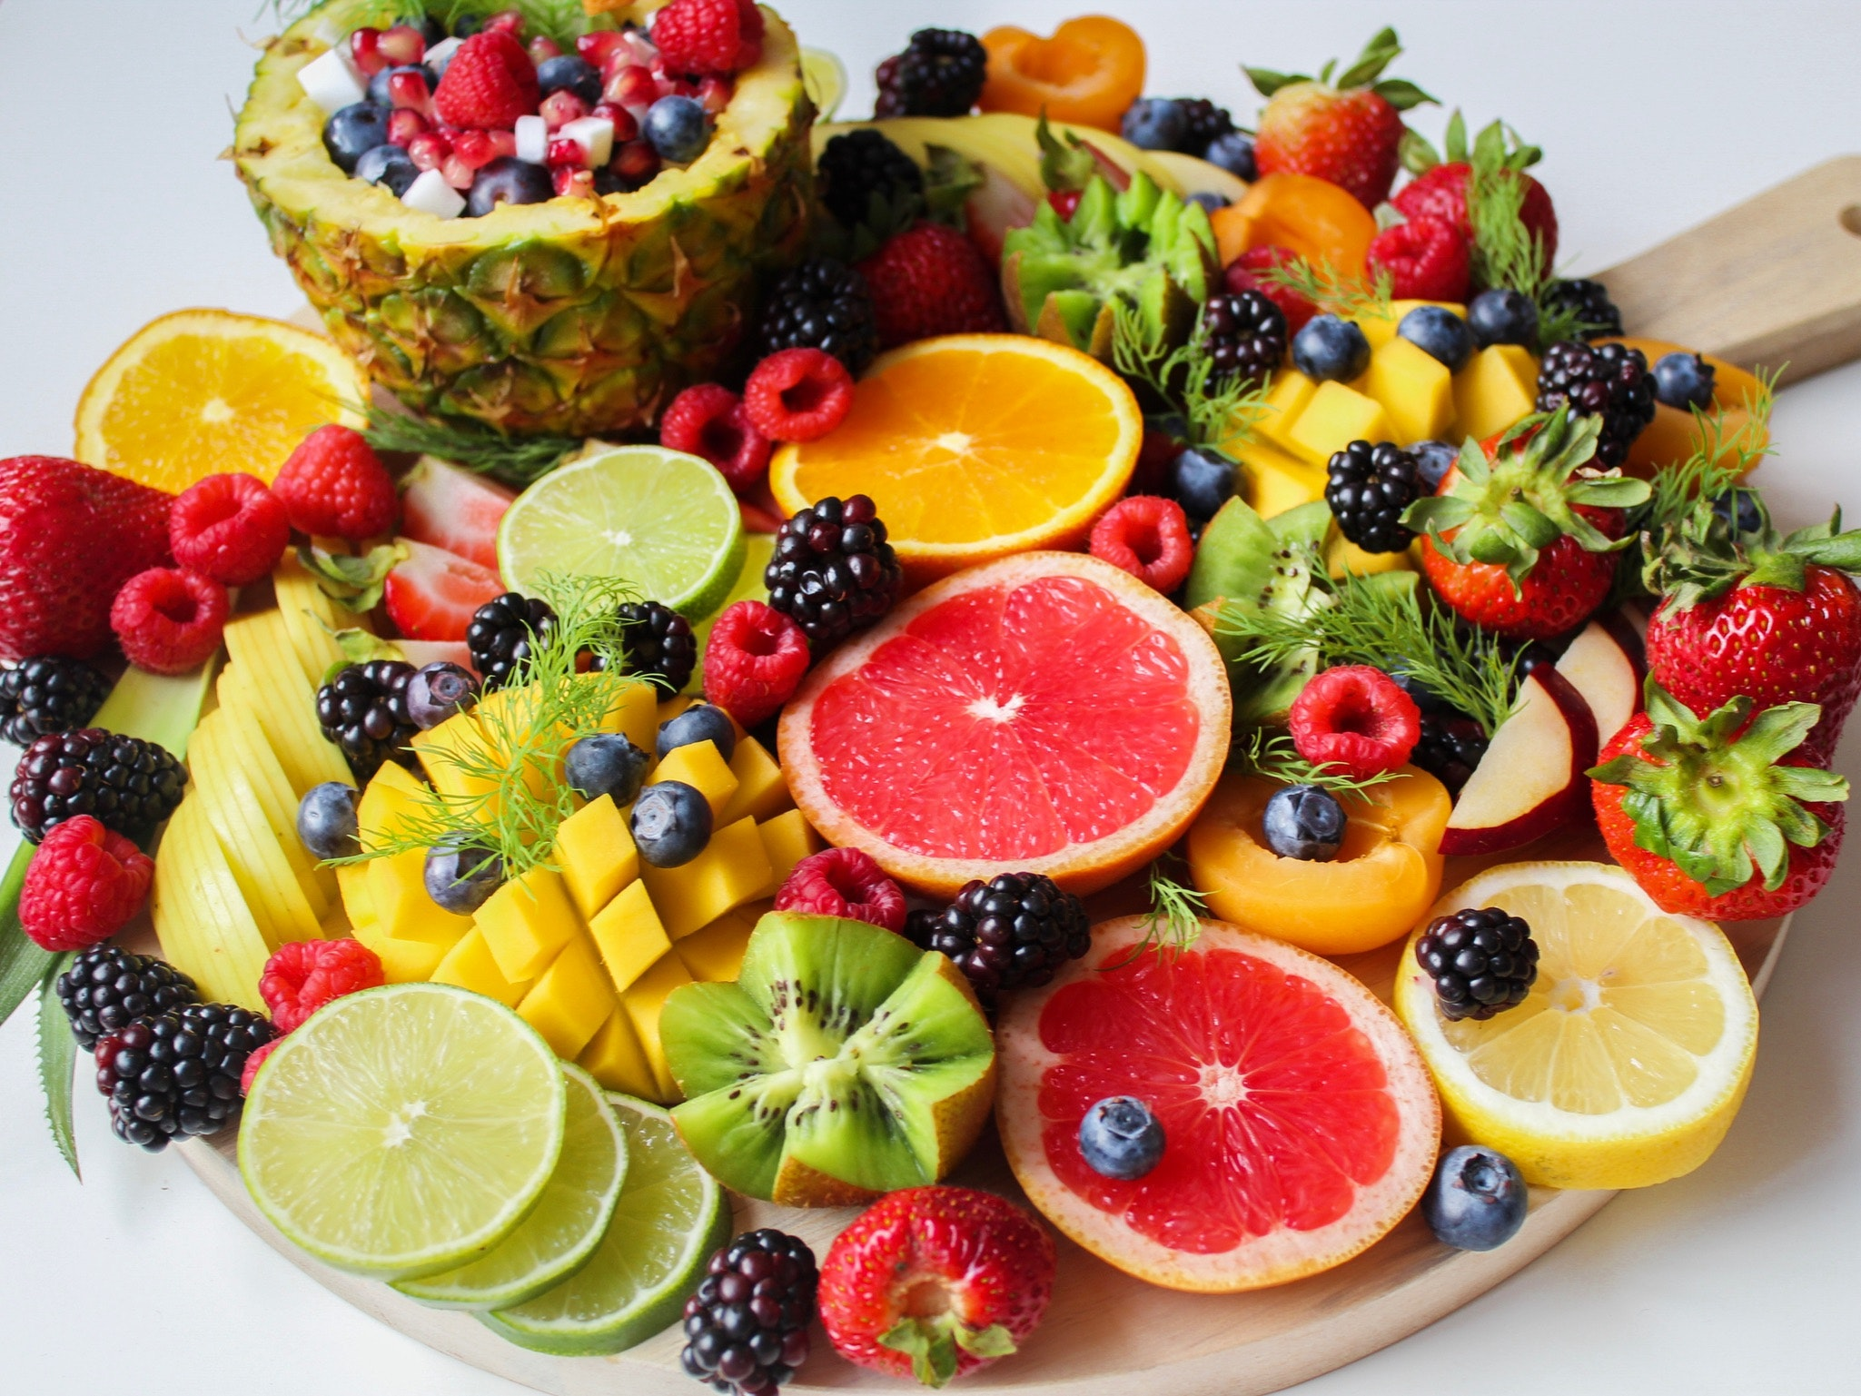
Smart Billing $$$ in a Fruit Shop
Introduction
Our goal?
To help people shop fruits in a smarter way by providing them with a variety of discounts and offers on their purchases.

Slide 3
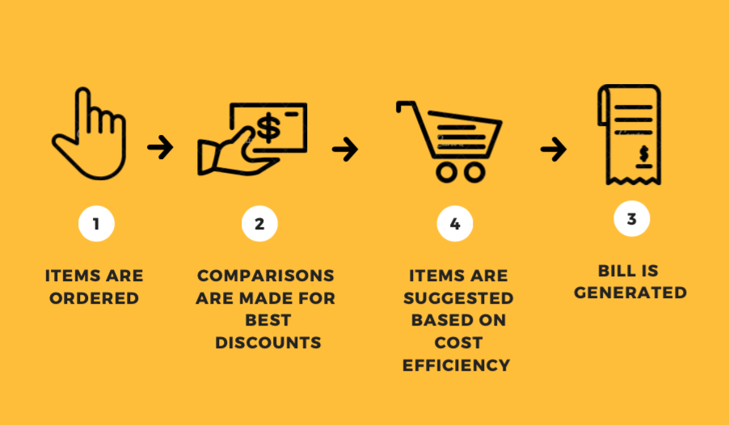
Methodology

Slide 4
Algorithm
Algorithm
INPUT--> LOGIC---> OUTPUT
INPUT: Item codes
LOGIC:
Suggests which other fruit to buy to avail combo offers :
Uses databases of fruits, costs, discounts and combos using dictionary data sets
Generates all possible combo offers from basket options using permutation function
Compares each combo to gives highest discount using for loops
OUTPUT: Discounted bill

Slide 5
Result analysis
Input | Output | Comments
101,102 | raspberry pear 6.93 | Offered multiple options
101,102,102 | Raspberry pear 12.3200 | Offered same options, removed duplicates
101,102,103,104,105 | 40% discount availed 19.439999999999998 | Offered direct discount of 40%
101,102,102,102,104,105 | pear 33.66000 | Offered options, removed duplicates

Slide 6
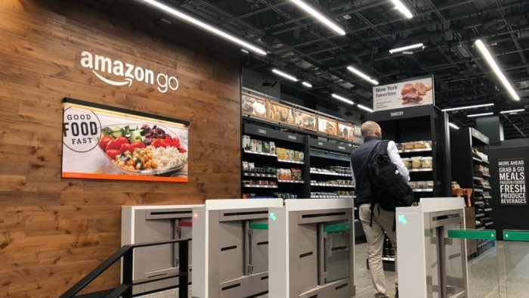
Corporate Use in AI
Literature Review
Customer experience enhancement
Cashier-free stores
Supply chain optimization
Market demand prediction
Loss prevention

Slide 7
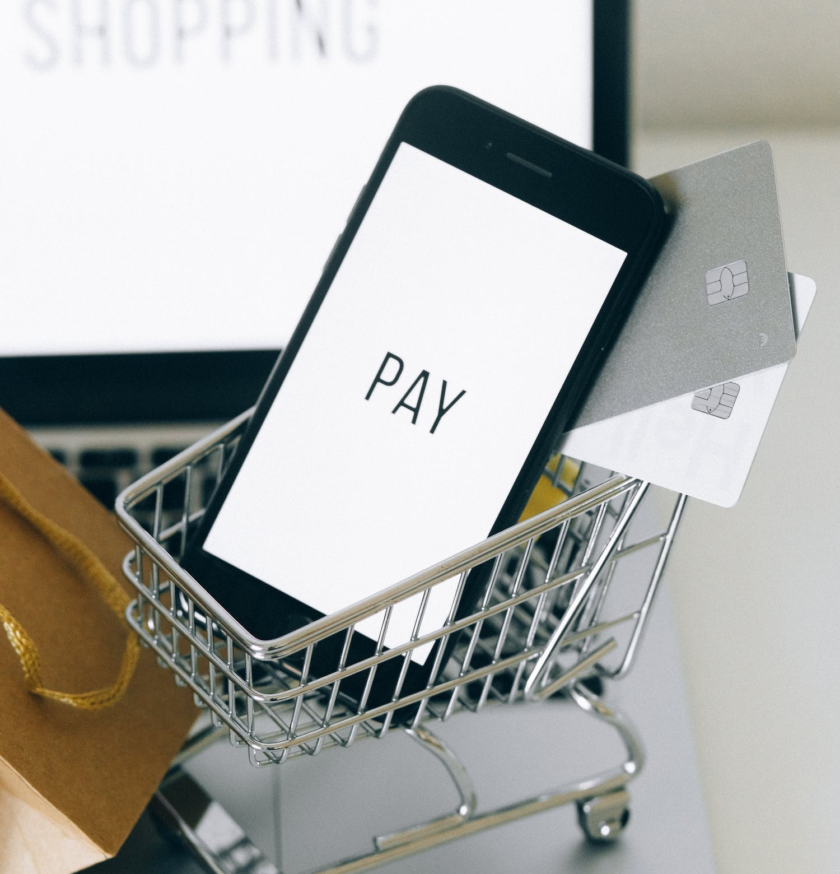
Applications of Smart Billing
Applications
Simple and intuitive work
Working with multiple documents
Handling of any payment forms
Viewing of item images
Bundle promotions
Issuing and processing of orders
Fast processing of returns and exchange of items
Document items can be assigned to different sales assistants

Slide 8
Advantage/Disadvantages
Advantages ​ | Disadvantages ​
Better customer service ​ | ​Cut in profit
Easier team management​ | Reliance on your internet connection ​
Quick Way to Drive Sales​ | Malware infections ​
Clear Out Old Stock | Lowered Perceived Value

Slide 9
References
https://www.expertmarket.com/ca/pos/pos-system-advantages-disadvantage
https://www.adchieve.com/en/blog/google-smart-shopping-the-pros-and-cons/
https://www.comarch.com/retail/pos-applications/
https://www.aiacceleratorinstitute.com/5-things-you-need-to-know-about-artificial-intelligence-in-retail/

Slide 10
Thank you

